Slide 1

GAME DEVELOPMENT using mutual exclusion

Slide 2

CONTENTS:
1.Abstract
2.Introduction
3.literature survey
4.System Requirements
5.Implementation
6.Results
7.conclusion

Slide 3
Abstract of the project
Mutual exclusion is a fundamental concept in computer science and concurrent programming, ensuring that only one process or thread can access a critical section of code at any given time.
In the context of game development, mutual exclusion plays a crucial role in maintaining game integrity and preventing conflicts between players.
The "dino game" we are referring to is likely the game that appears in the Google Chrome web browser when there's no internet connection. In this game, a dinosaur character runs across the screen, and the player can make it jump over obstacles.

Slide 4

Introduction:
In a multiplayer version, you would need to manage access to shared data (like scores, game state, etc.) to prevent race conditions and data corruption. This is where mutual exclusion mechanisms, such as locks or semaphores, would come into play.
If you had multiple dinosaurs on the screen or if there were shared resources (such as a scoring system) that different parts of the program needed to access simultaneously, you need to implement mutual exclusion to prevent conflicts and ensure the proper functioning of the game.

Slide 5

LITERATURE SURVEY:
Book Title: “Operating System Concepts"
Authors: ABRAHAM SILBERSCHATZ, PETER BAER GALVIN, GREG GAGNE
Edition: TENTH
Publisher: WILEY
We referred to this book to understand what is Mutual Exclusion, Critical Section and how to use these concepts to write a code for a game

Slide 6
Game Development Books –
Titles:"GameEngine Architecture" by Jason Gregory can be helpful.
Paper Title: “A Review of various Mutual Exclusion Algorithms in Distributed Environment”
● Authors: NISHA YADAV, SUDHA YADAV, SONAM MANDIRATTA
● Publication Year: 2015

Slide 7
System requirements:
1. Operating System:
- The Dino Game is a web-based game and is platform-independent. It should work on various operating systems, including Windows, macOS, Linux, and Chrome OS.
2. Web Browser:
- The game is designed to run in the Google Chrome web browser. It may also work in other modern browsers, but it's specifically optimized for Chrome.
3. Internet Connectivity:
- While the game is often associated with offline play (when there is no internet connection available), having a functional internet connection to load the initial page where the game is hosted is required.

Slide 8
4. Browser Version:
- The Dino Game may have specific optimizations for certain versions of the Chrome browser. It's recommended to use an up-to-date version of Google Chrome for the best experience.
5. Hardware:
- The Dino Game is lightweight and does not require high-end hardware. It should run smoothly on most modern computers, laptops, and even on some mobile devices.
6. Browser Settings:
- Ensure that JavaScript is enabled in your browser settings, as the game relies on this scripting language for its functionality.
7. Graphics Card:
The Dino Game does not have high graphics demands, and it can run on systems with integrated graphics or basic dedicated graphics cards.
Any modern graphics card capable of rendering 2D graphics should be sufficient.

Slide 9
Implementation:
steps for implementing mutual exclusion in a Dino Game:
1. Identify Shared Resources:
- Identify the variables or data that multiple parts of your game might access or modify concurrently, such as scores or game state.
2. Choose a Synchronization Mechanism:
- Pick a synchronization tool like locks or semaphores to control access to shared resources.
3. Implement Locking Mechanisms:
- Use locks to protect critical sections of your code. Acquire the lock before entering a critical section and release it afterward.

Slide 10
4. Apply Locks to Game Logic:
- Identify parts of your Dino Game code where shared resources are accessed and apply locks to those sections.
5. Test for Concurrency Issues:
- Test your game with multiple threads or players to identify and fix any issues related to concurrent access.
6. Optimize and Refine:
- Continuously refine your implementation for efficiency. Consider using finer-grained locks and optimize critical sections.

Slide 11

Creating a game using Python in PyCharm involves several steps. Below is a basic outline to get you started. I'll use the Pygame library for simplicity, but there are other game development libraries you can explore as well.
Step 1: Install Pygame
Before you start, you need to install the Pygame library. Open a terminal or command prompt and run:
Step 2: Set Up PyCharm
If you haven't already, download and install PyCharm from the official website. Open PyCharm and create a new Python project.

Slide 12
Step 3: Create a Python File
In PyCharm, right-click on your project folder, select New, and then choose Python File. Give your file a name (e.g., game.py).
Step 4: Write Your Game Code
Write the code for your game. Here's a simple example using Pygame:
Step 5: Run Your Game
Click the green "Run" button in PyCharm to execute your game. You should see a window with a blue rectangle.
Step 6: Expand Your Game
Continue building your game by adding more features, images, sounds, and logic. Pygame has extensive documentation that can guide you: Pygame Documentation.

Slide 13
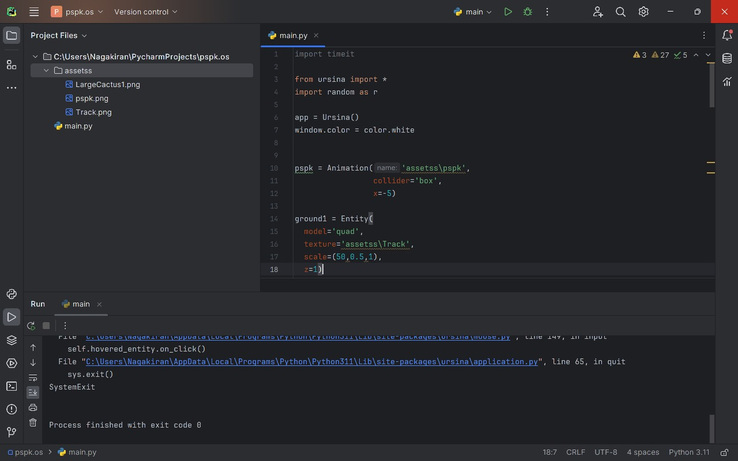
Results:

Slide 14
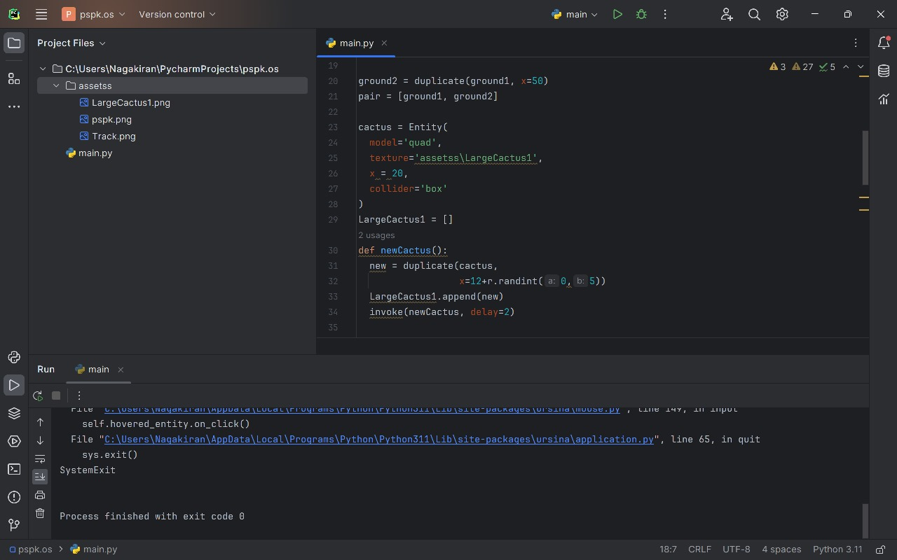

Slide 15
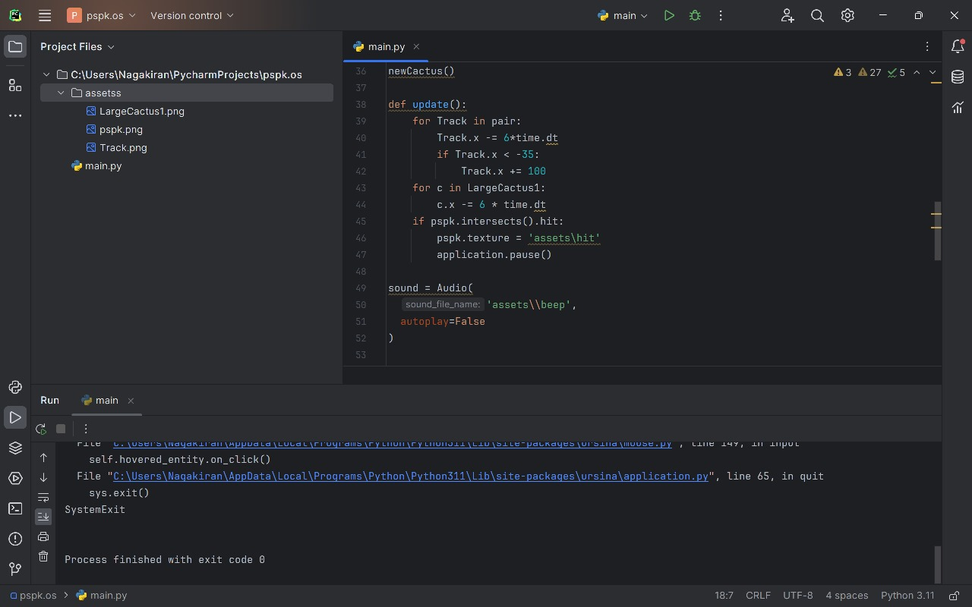

Slide 16
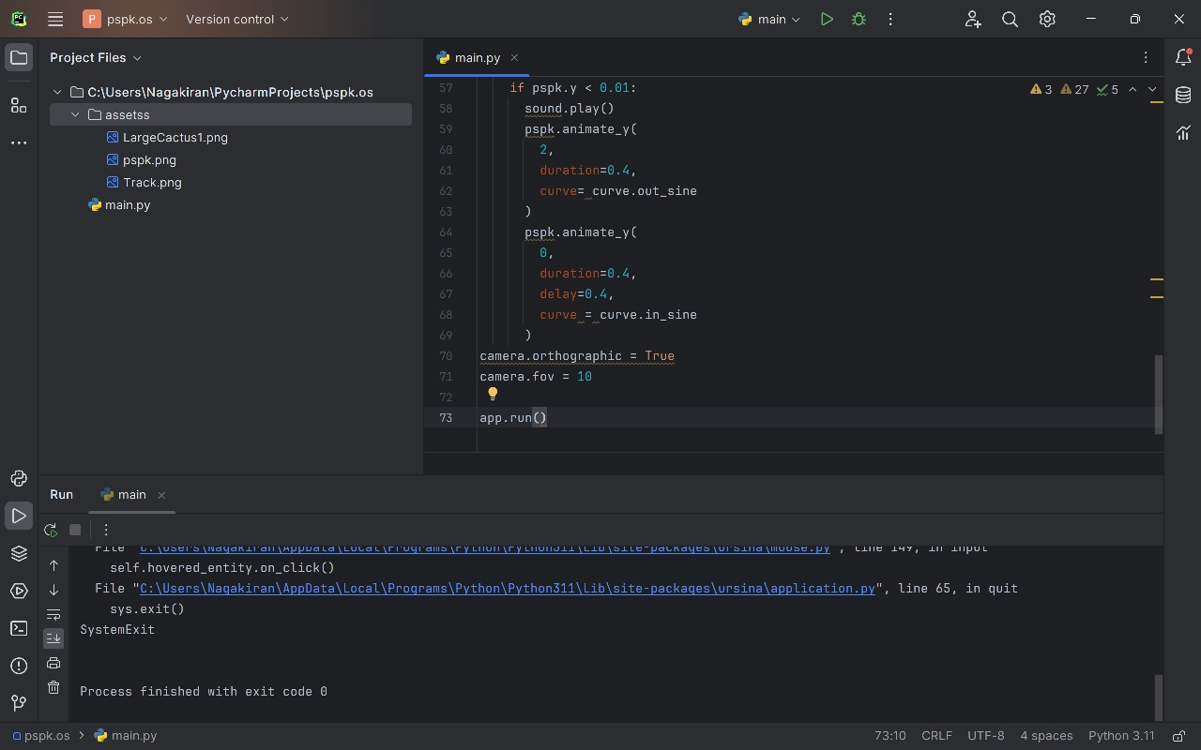

Slide 17
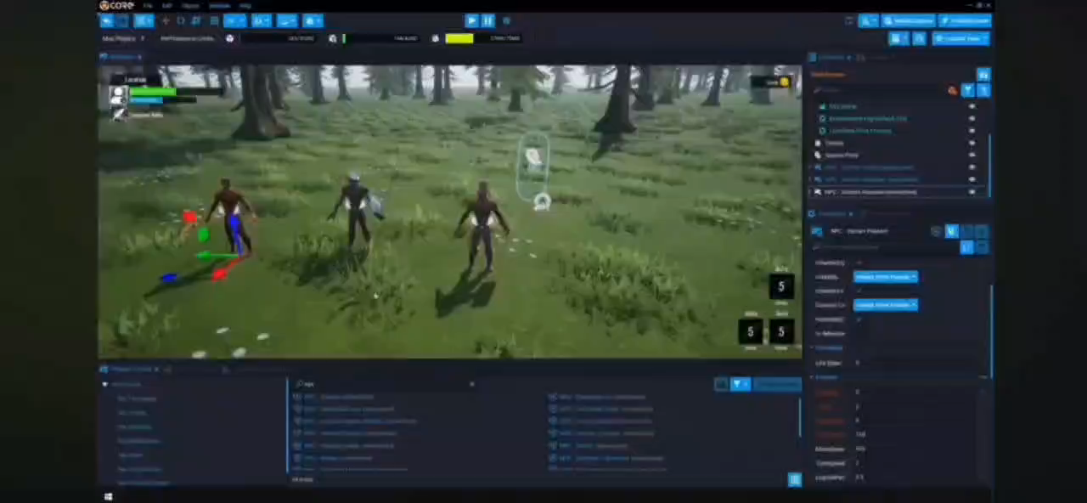

Slide 18
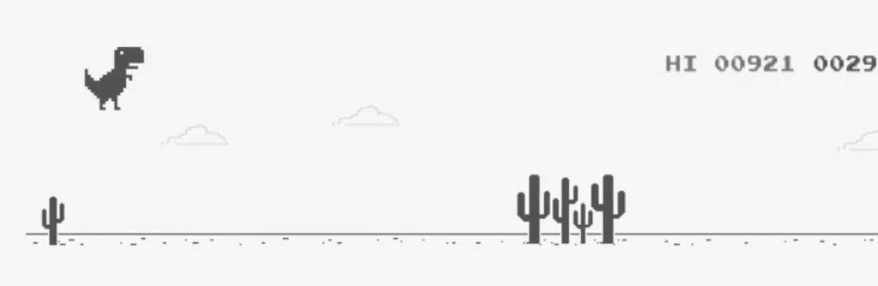
THANK YOU
PRESENTED BY:
SAIDINESH :RA2211029010016
NAGA KIRAN :RA2211028010230
RAHUL :RA2211029010024

